Slide 1

EY TAX ADVISORY & REGULATORY AUTOMATION
TAX LAW DELTA ANALYZER
Deterministic Regulatory State-Diffing and Local Context Refinement Engine
PRESENTER
EVALUATION METADATA
Anshul Kumaria
Enterprise AI POC • Token Optimization • Zero-Hallucination Compliance

Slide 2
PROBLEM STATEMENT
The Operational Bottleneck in Corporate Tax Advisory
The Manual Highlighter Struggle
The Commercial Cloud LLM Dilemma
Consultants spend hours cross-referencing new 50+ page PDFs against prior codifications.
Ingesting dual 50-page PDFs burns ~50k+ tokens per transaction ($0.25+/query).
Human fatigue leads to missed clause updates, sunset provisions, and miscalculated effective dates.
Lost-in-the-Middle: Severe attention degradation in large contexts (e.g., missing 100% to 80% phase-downs).
Transmitting full regulatory drafts outside client boundaries triggers governance hurdles.
"Sending entire documents to cloud models is expensive and error-prone. The solution is local deterministic diffing before cloud ingestion."

Slide 3
ARCHITECTURE
Automated Pipeline: Document Ingestion to Executive Synthesis
STEP 1
STEP 2
STEP 3
Ingestion Engine
Deterministic Diffing
Local Refinement
pdf_parser.py strips running headers, disclaimers, and page numbers to prevent false diffs.
diff_engine.py segments statutory sections, isolating changes and bypassing the 90-95% unchanged baseline.
Ollama worker (Llama 3.2) standardizes raw diff text into a typed, validated semantic JSON payload locally.
STEP 4 & TELEMETRY
Primary LLM Synthesis & SQLite Tracking
Primary LLM receives a lightweight ~1,000-token payload to generate the executive EY Client Impact Summary. All execution runs and token savings are logged to SQLite (contextsentry.db).

Slide 4
CODEBASE INFRASTRUCTURE
Modular Backend Infrastructure & Deliverables
pdf_parser.py
diff_engine.py
worker.py
Layout-aware text extractor with bounding-box marginalia stripping.
Deterministic clause parser isolating MODIFIED, ADDED, and REMOVED sections.
Two-stage worker (Ollama Llama 3.2 JSON cleaner + Primary LLM synthesizer).
telemetry.py
server.py
viewer.py
ContextSentry SQLite tracking engine logging token ROI in contextsentry.db.
Dual-interface serving Model Context Protocol (MCP) tool 'compare_regulatory_documents' and FastAPI REST API.
Interactive terminal diff inspector with section filtering (--section) and ANSI color diffs.

Slide 5
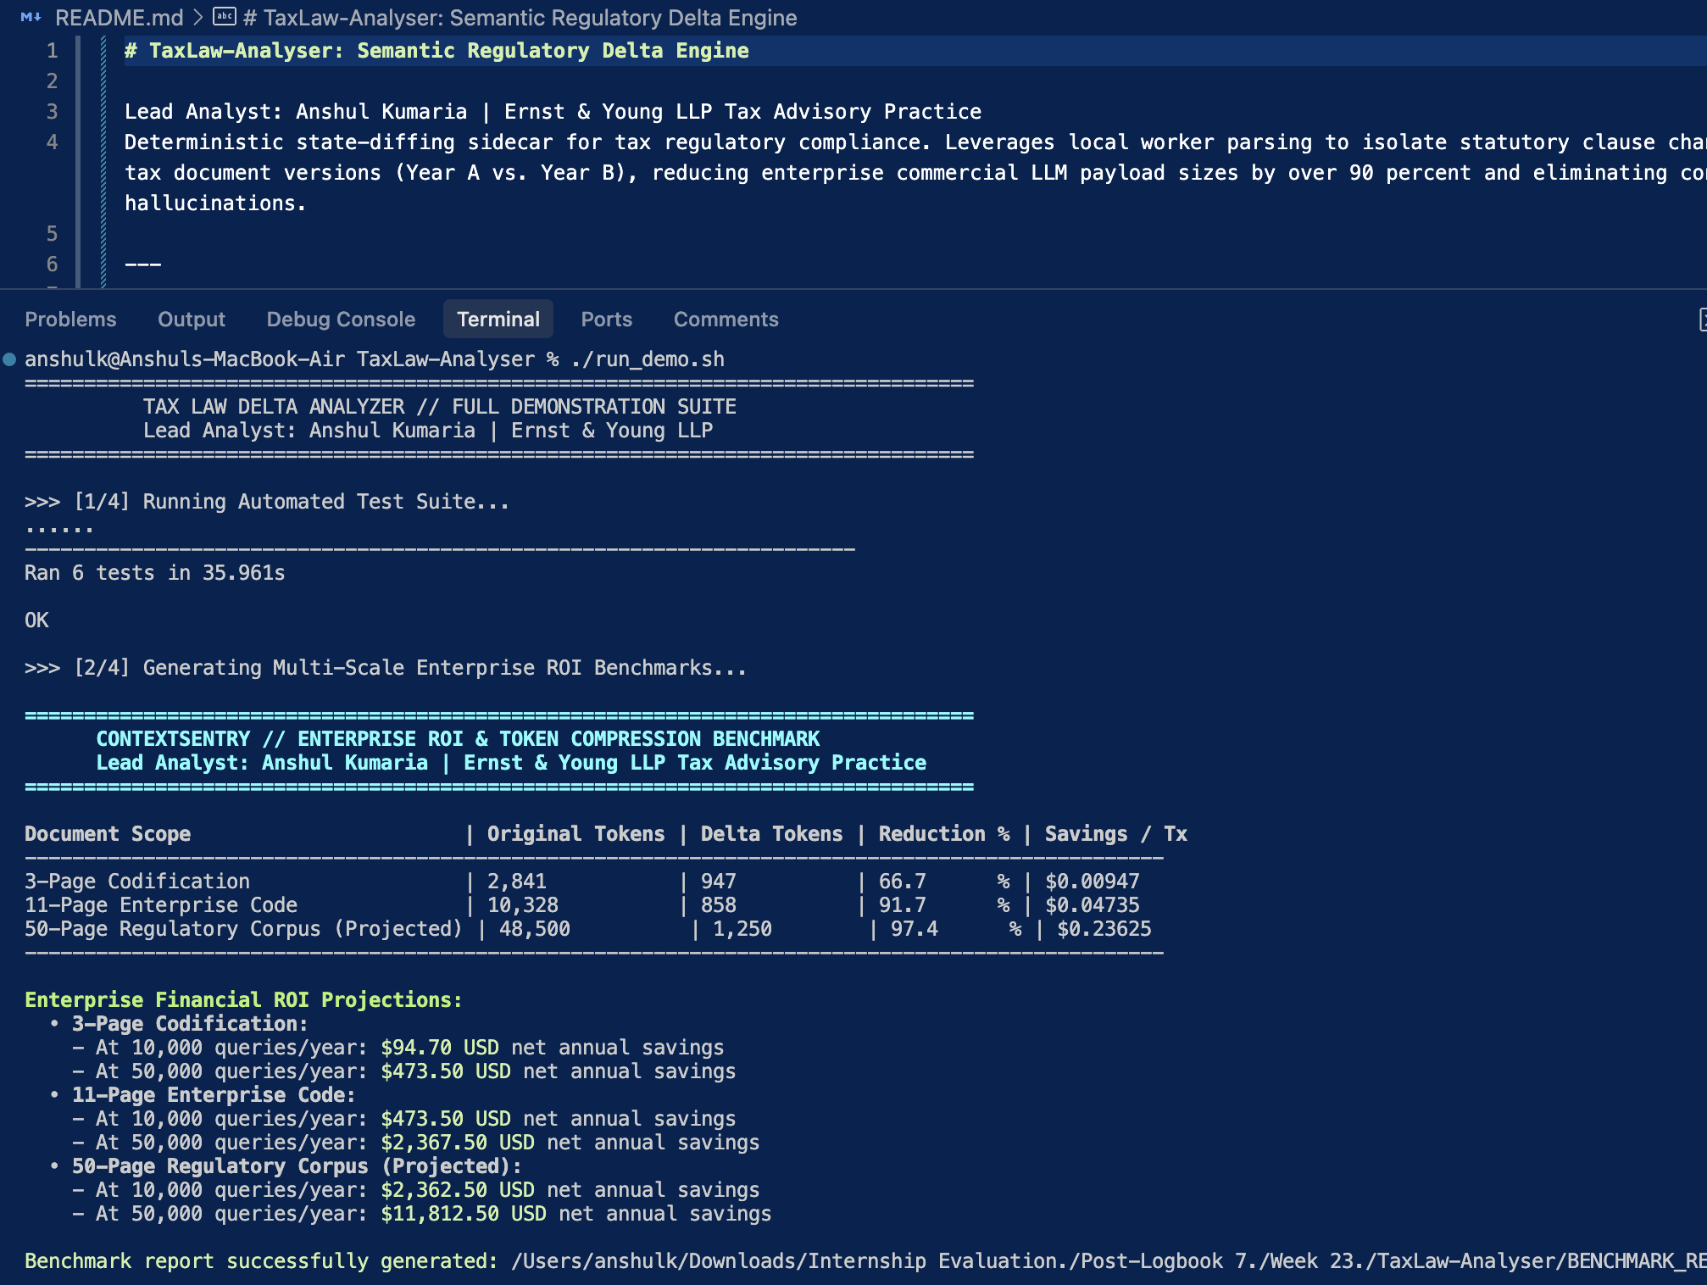
VERIFICATION & ROI
Automated Test Suite & Multi-Scale Financial Benchmarks
Robust Test Suite
100% automated test pass (Ran 6 tests in 35.9s OK) covering marginalia filtering, diff calculations, and MCP protocol compliance.
Multi-Scale Token Savings
• 3-Page Codification: 66.7% Reduction ($0.00947 saved)
• 11-Page Enterprise Code: 91.7% Reduction ($0.04735 saved)
• 50-Page Regulatory Corpus: 97.4% Reduction ($0.23625 saved)
Firm Financial Impact
Over $11,812 USD annual net savings per practice group at 50k annual queries.
Caption: Terminal output showing unit test suite execution and multi-scale token compression benchmark matrix.

Slide 6
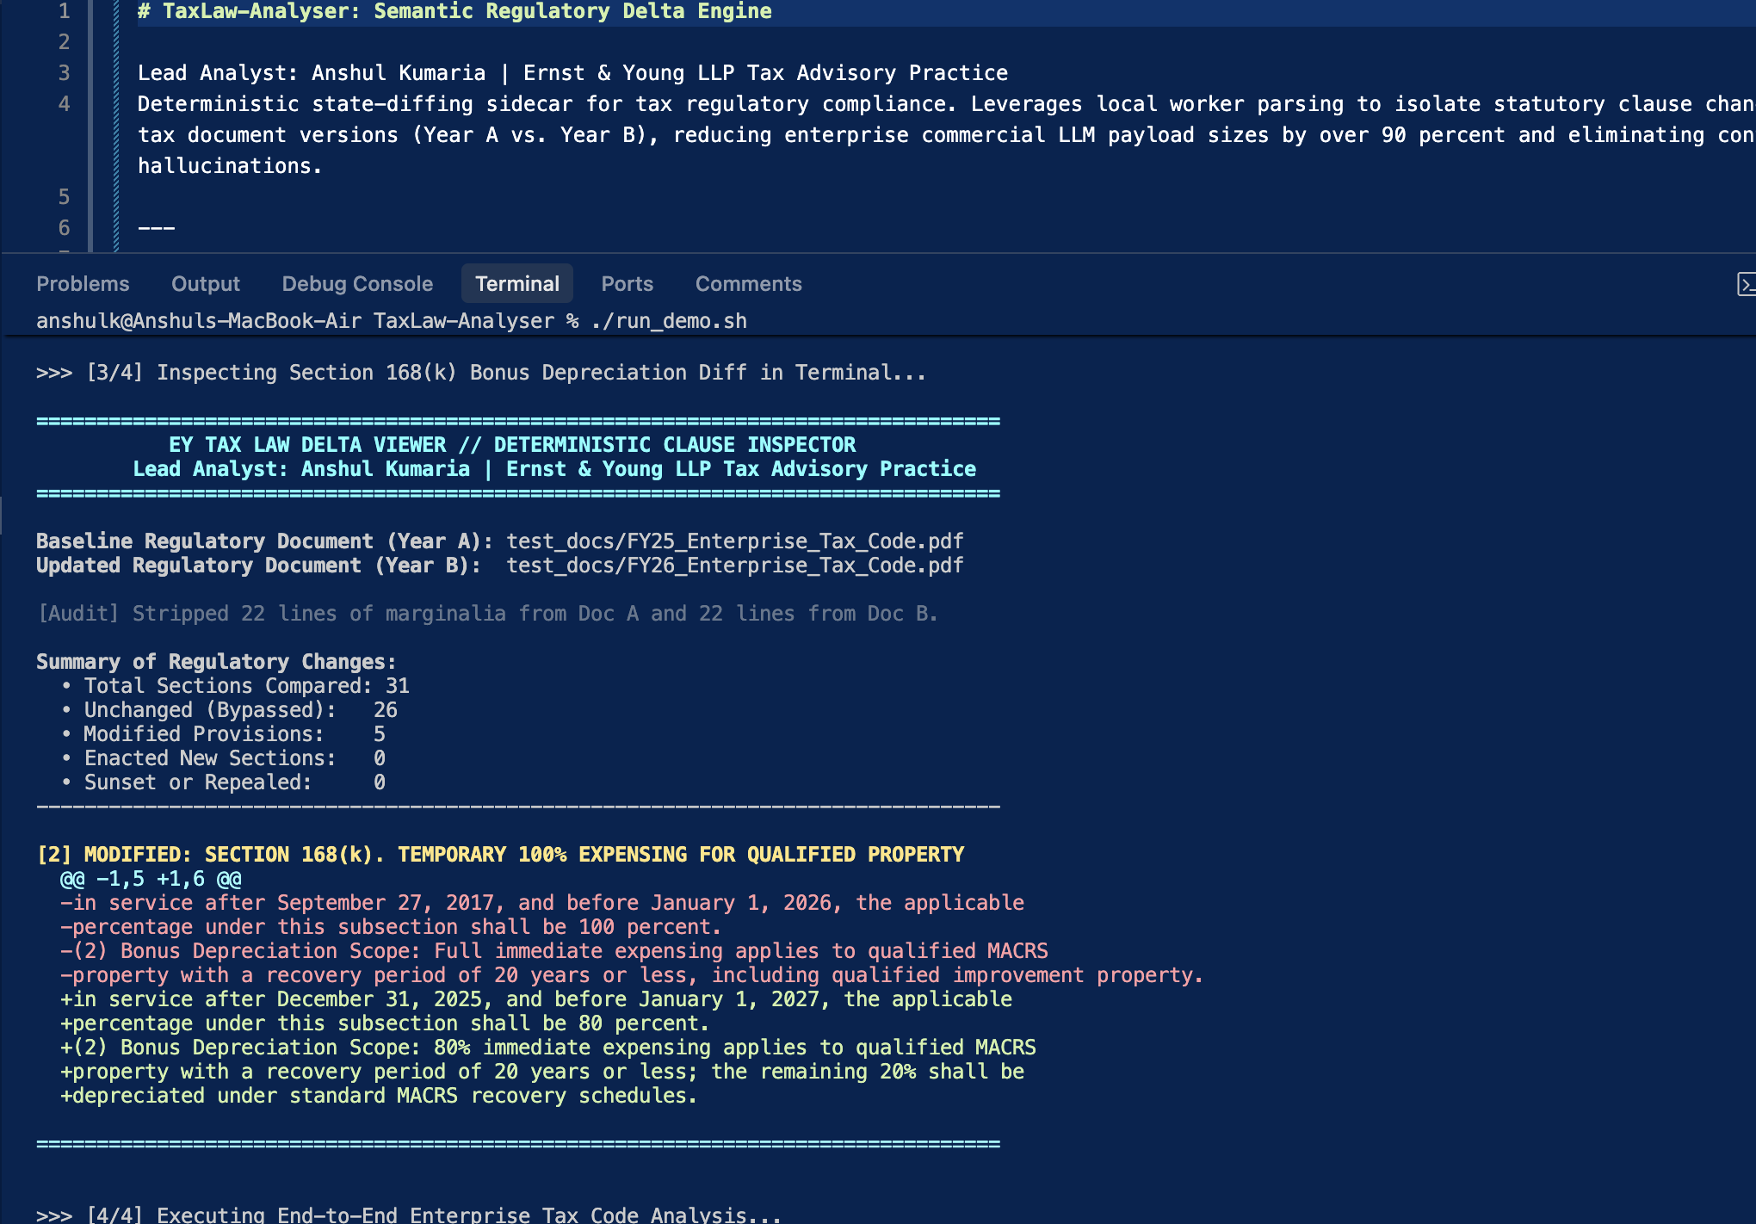
AUDIT TRAIL
Eliminating Noise: Deterministic Audit Trail
Marginalia Elimination
Stripped 22 lines of running headers, disclaimers, and page numbers per document, preventing false-positive diffs.
Section Isolation
Evaluated 31 statutory sections; 26 unchanged sections were identified and completely bypassed.
Section 168(k) Audit
Isolated the phase-down from 100% to 80% bonus depreciation for property placed in service after Dec 31, 2025.
Caption: viewer.py rendering Section 168(k) with red deletions (- 100%) and green additions (+ 80%) after stripping marginalia.

Slide 7
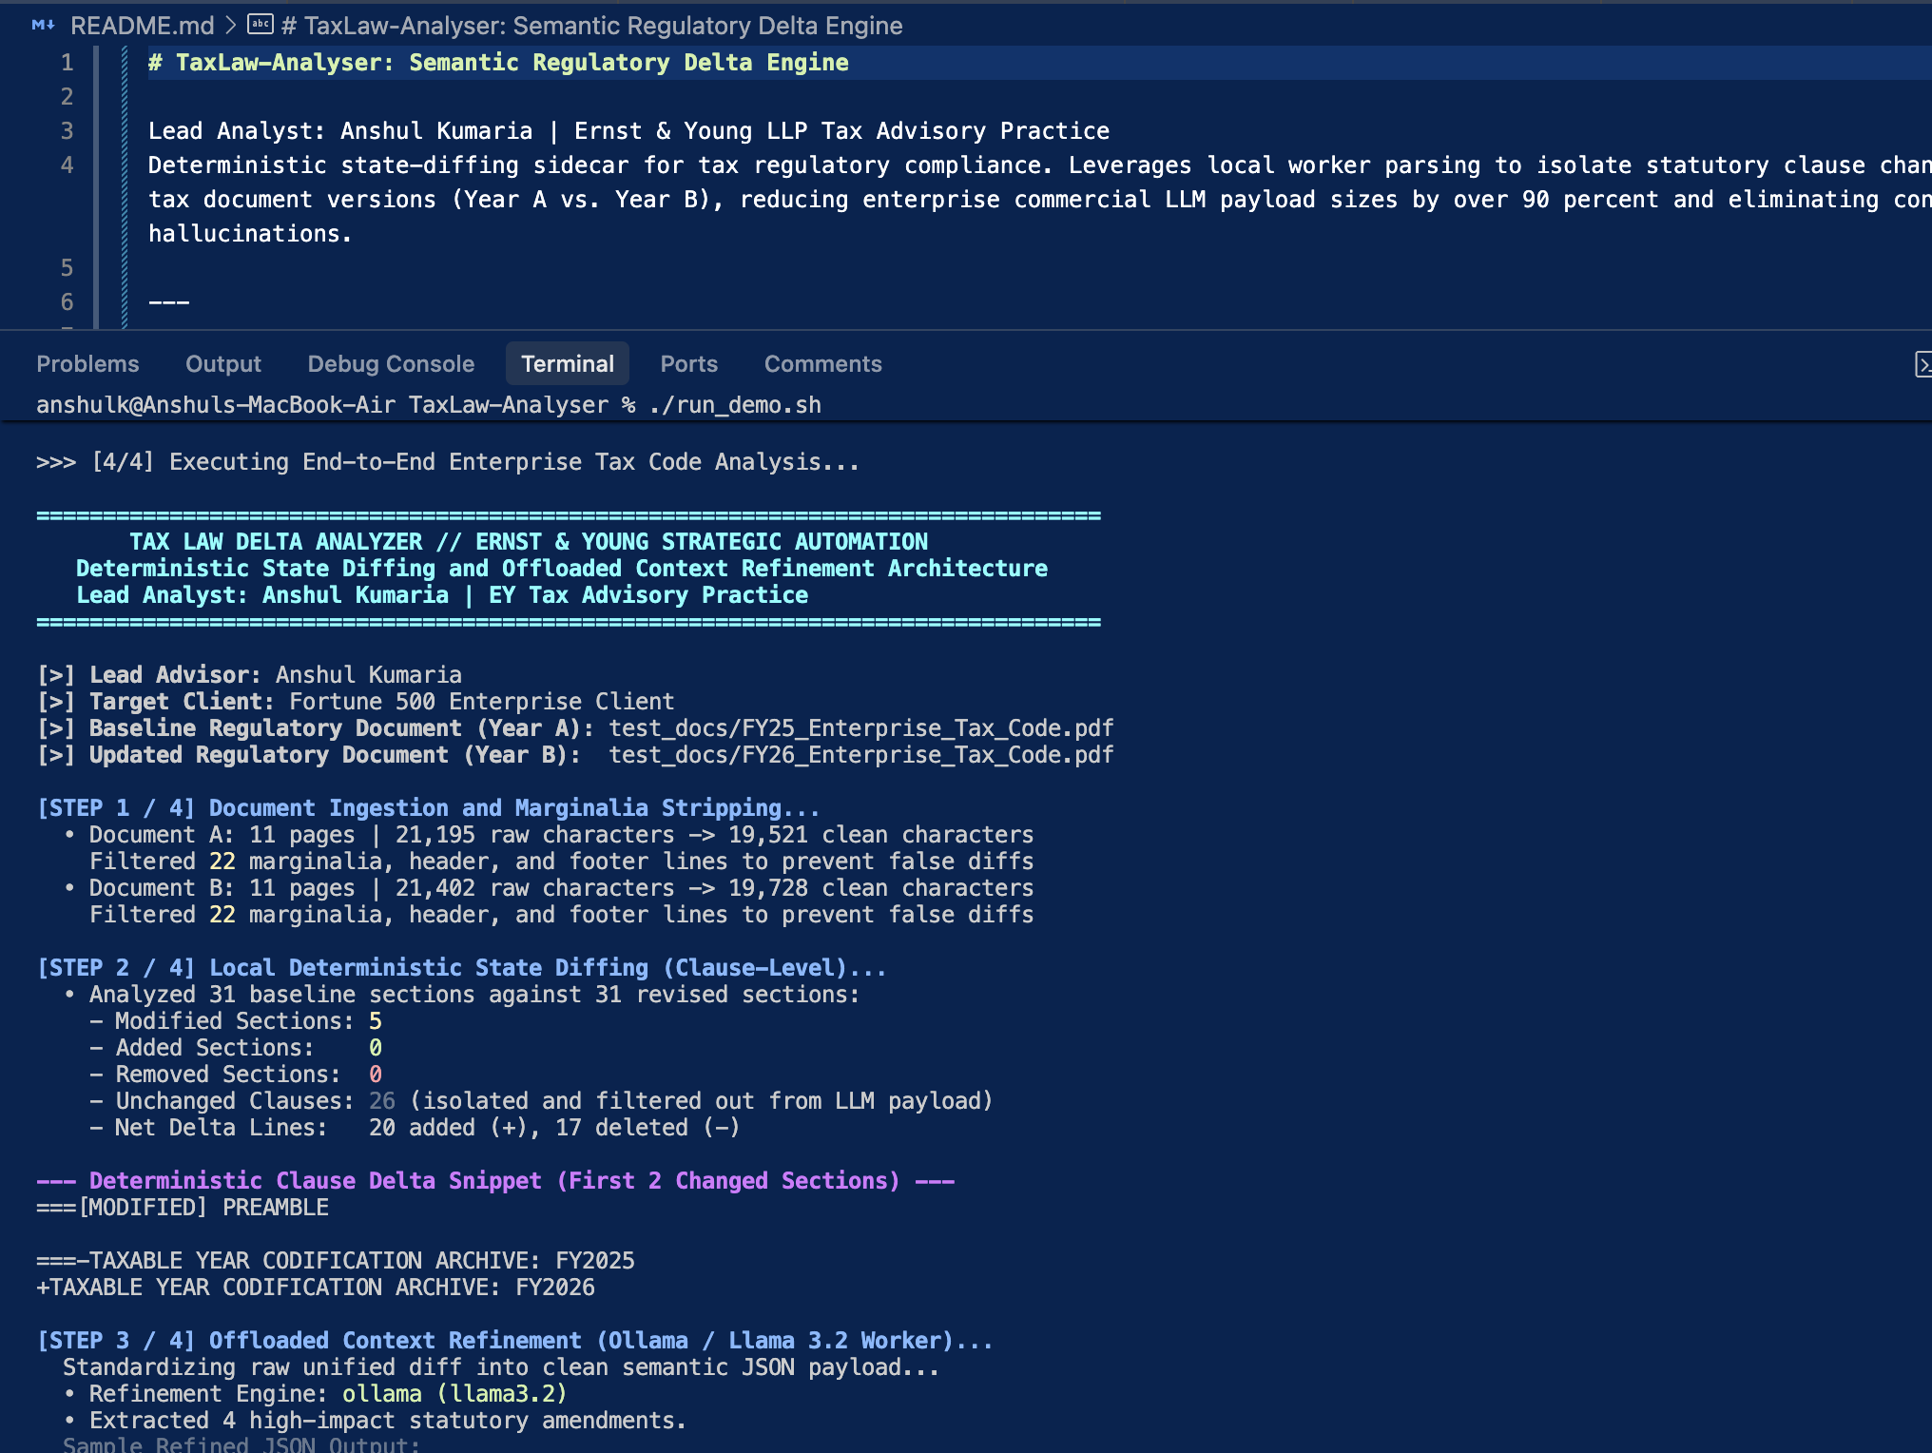
INGESTION & SEGMENTATION
Real-World Ingestion on 11-Page Enterprise Codifications
Engagement Target
Fortune 500 Enterprise Client codification analysis.
Document Ingestion Metrics
• Doc A: 11 pages | 21,195 chars → 19,521 clean chars (22 marginalia lines removed)
• Doc B: 11 pages | 21,402 chars → 19,728 clean chars (22 marginalia lines removed)
Deterministic Delta
5 modified sections isolated; 26 unchanged sections shielded from the LLM context window.
Caption: cli.py Step 1 & Step 2: Ingestion, layout-aware marginalia stripping, and clause-level diff segmentation.

Slide 8
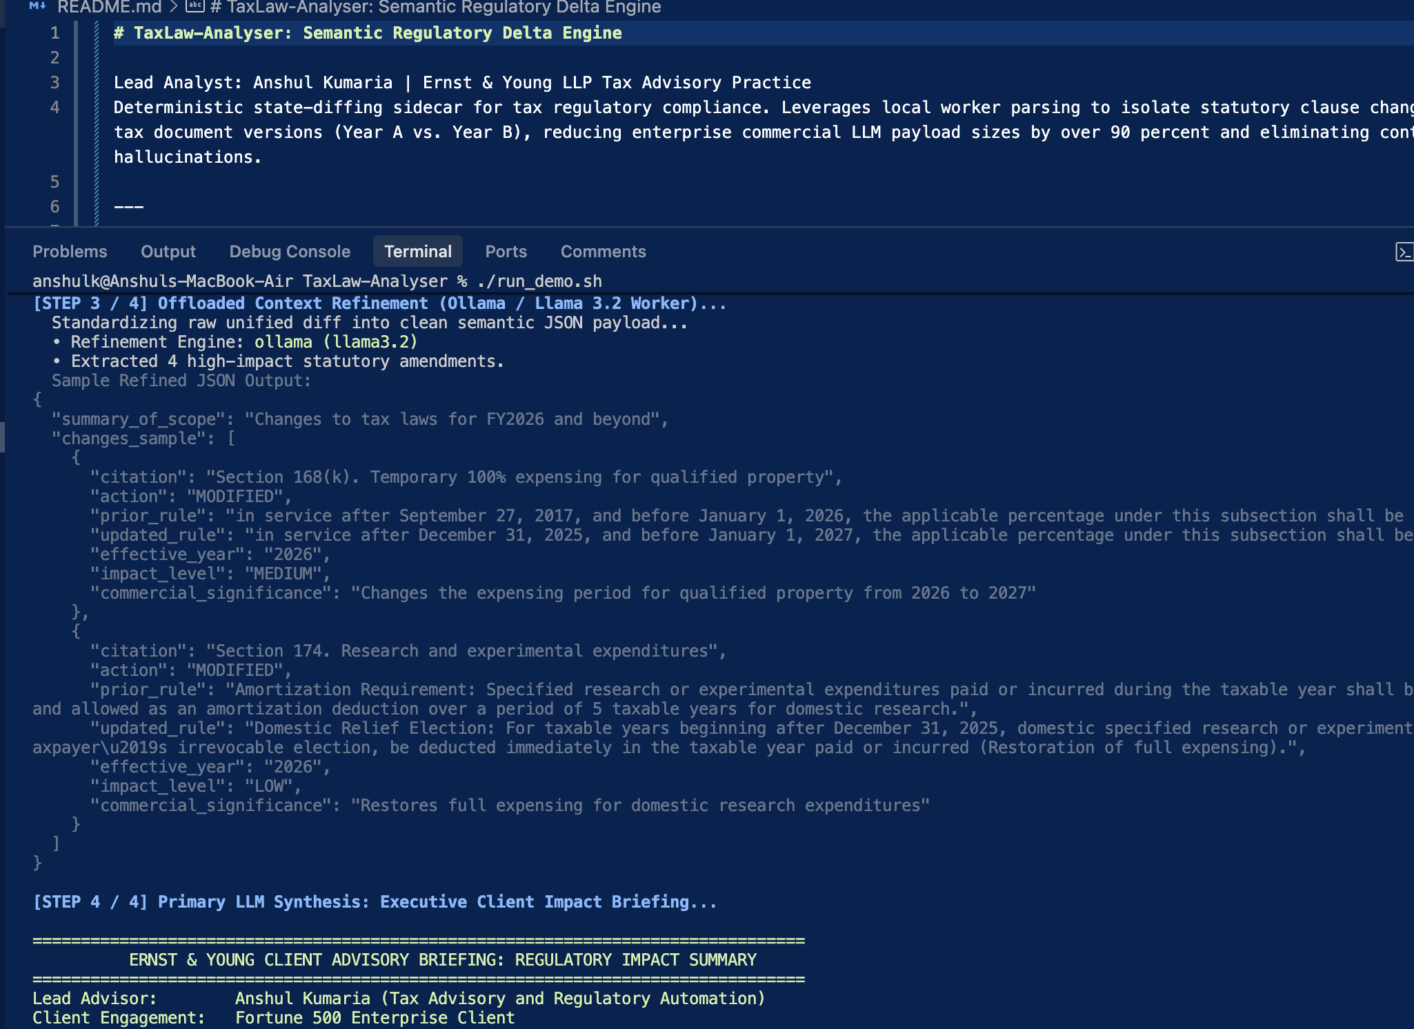
CONTEXT REFINEMENT
Offloading Noise to Local LLM Workers
Local Data Sanitization
Raw diff syntax (+/- line diffs) is standardized on an on-premise Ollama worker running Llama 3.2.
Zero Cloud API Cost
Noise cleaning and JSON structuring happen locally at zero cloud compute cost.
Structured Semantic Output
Outputs strict JSON capturing statutory citation, prior rule, updated provision, effective taxable year, and impact level.
Caption: cli.py Step 3: Ollama (Llama 3.2) structured JSON output isolating Section 168(k) and Section 174 regulatory amendments.

Slide 9
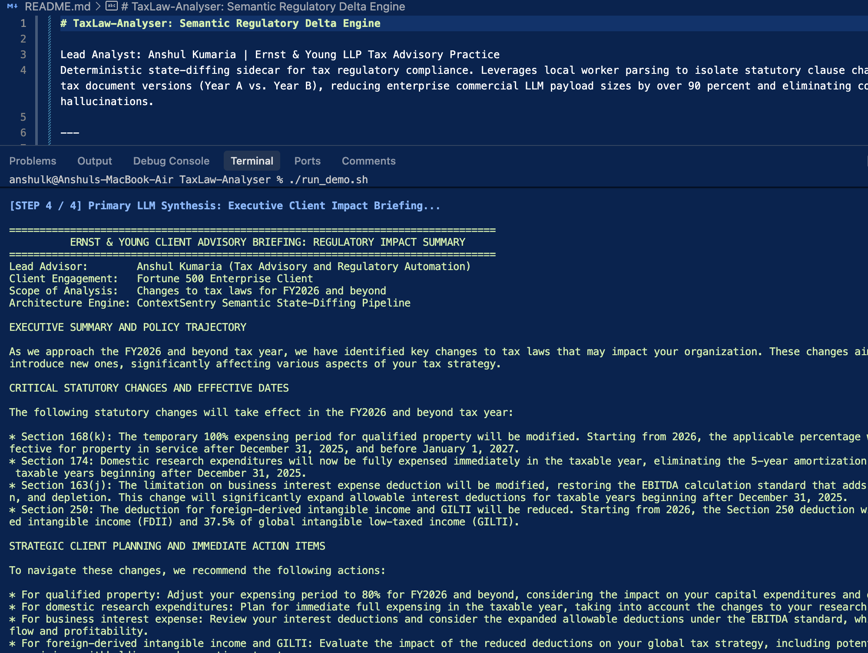
CLIENT ADVISORY
Executive Client Advisory Briefing Generation
Lead Advisor
Anshul Kumaria
Strategic Advisory Sections
• Section 1: Executive Summary & Macro Policy Trajectory
• Section 2: Statutory Amendments & Effective Dates (Sec 168k, 174, 163j, 250)
• Section 3: Strategic Planning Action Items (Capex acceleration, R&D election)
Professional Grade
Clean executive plain-text typography with zero markdown clutter.
Caption: cli.py Step 4: Authoritative plain-English EY Client Advisory Briefing synthesized by Primary LLM.

Slide 10
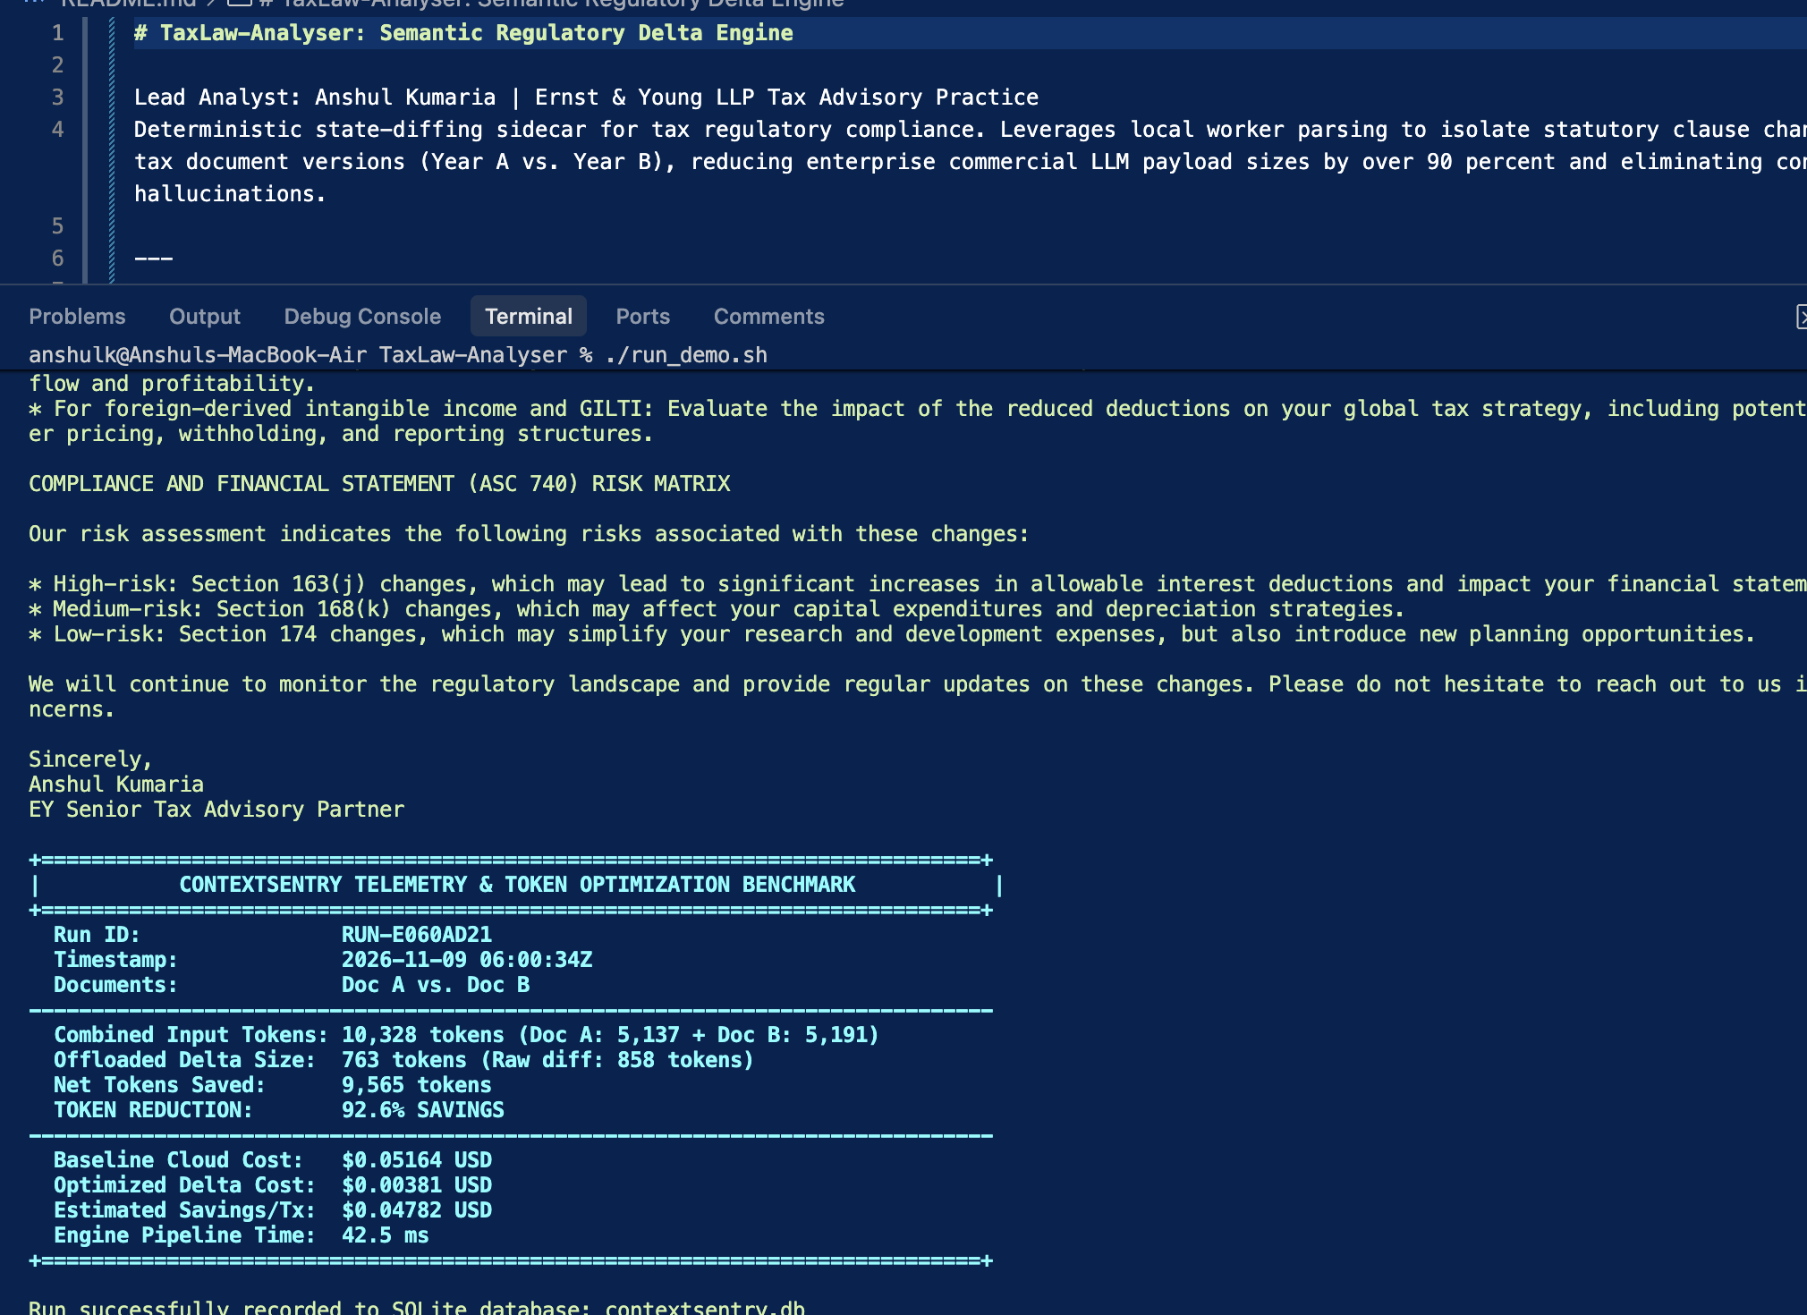
ACCOUNTING RISK & METRICS
Financial Accounting Risks & Empirical Token Savings
ASC 740 Financial Accounting Risks
Identifies deferred tax asset/liability swings and discrete interim period reporting requirements.
Empirical Token Optimization
• Combined Size: 10,328 tokens | Offloaded: 763 tokens
• Net Saved: 9,565 tokens
• EMPIRICAL TOKEN REDUCTION: 92.6% SAVINGS
Cost & Latency
Baseline cloud cost $0.05164 → $0.00381 ($0.04782 saved/tx); pipeline latency: 42.5 milliseconds.
Caption: cli.py Step 5: ASC 740 risk matrix and ContextSentry benchmark card proving 92.6% token reduction recorded to contextsentry.db.

Slide 11
ENTERPRISE VALUE
Delivering Tangible Business Value to EY Tax Practices
TOKEN OPTIMIZATION — 92.6% SAVINGS
ZERO HALLUCINATIONS — 100% ATTENTION
Payload reduced from 10,328 to 763 tokens; scales to 97.4% on 50-page regulatory corpora, saving over $11,800/year per practice group.
Deterministic clause isolation guarantees zero missed sunset clauses or threshold changes ("Lost in the Middle").
CONSULTANT VELOCITY — 42.5 MILLISECONDS
SOVEREIGNTY & AUDITABILITY — SQLITE & MCP READY
Replaces 3+ hours of manual highlighter comparisons with an asynchronous pipeline executing in seconds.
Local worker keeps drafts sovereign; Model Context Protocol server connects seamlessly to AI agent ecosystems while logging every query in contextsentry.db.

